Slide 1
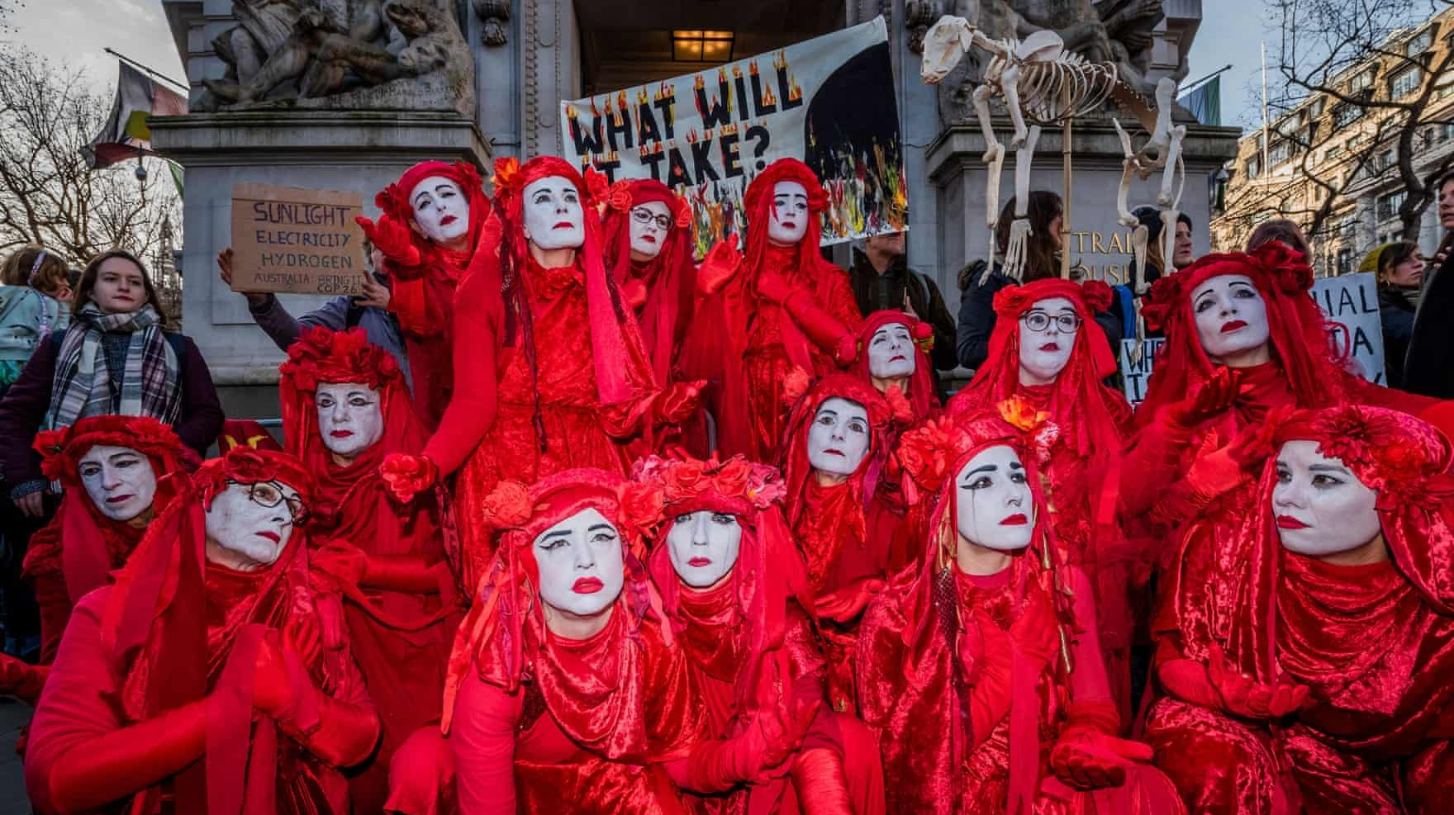

Slide 2
It's 20th of April 2020, the world is still in lockdown. Everyone that is able to go outside is seen wearing masks. Billions and billions of masks, maybe even more than a trillion, have been sold in a very short time. There's definitely a shortage of masks, but why do people wear them now? Where were the masks on the faces of PEOPLE OF SARAJEVO in January when Sarajevo was declared the most air-polluted city in the world for more than just one day? Sarajevo, the most air-polluted place in the world, where there are no factories even, had worse air than Beijing! Air pollution affects everyone, not just old or sick people or those with a weak immune system, so why did everyone say "meh" to that?

Slide 3
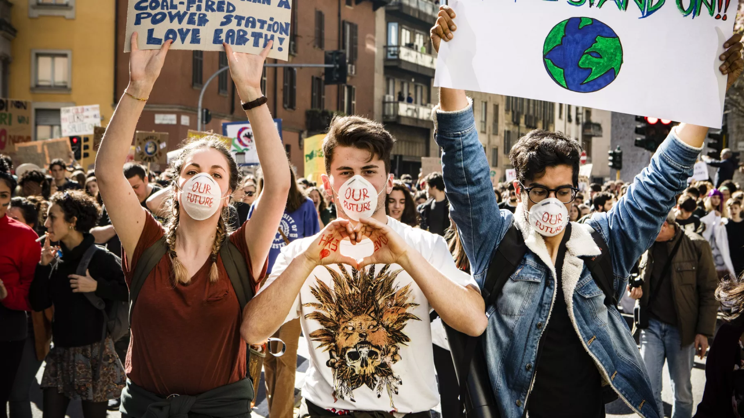
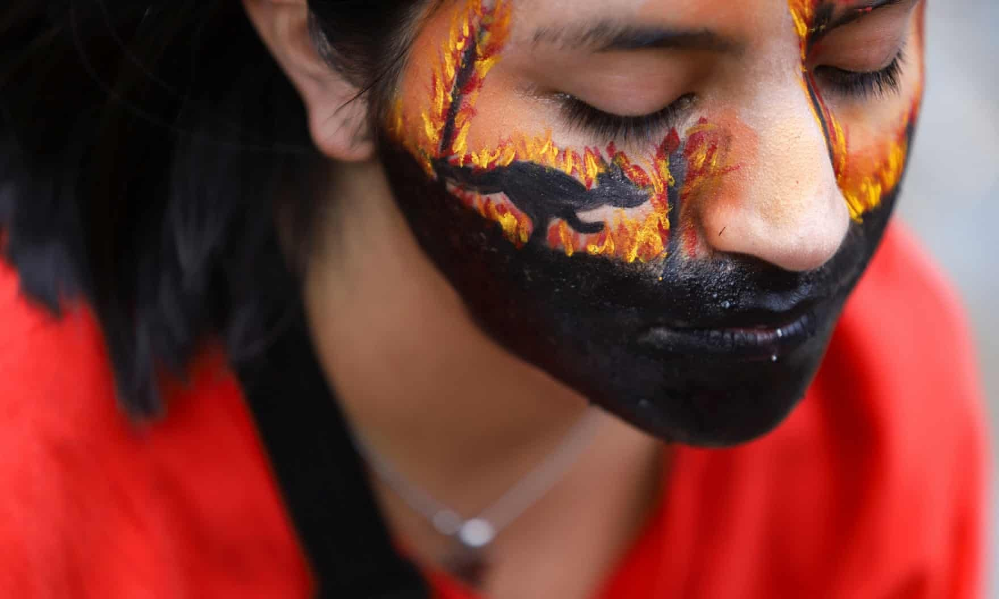
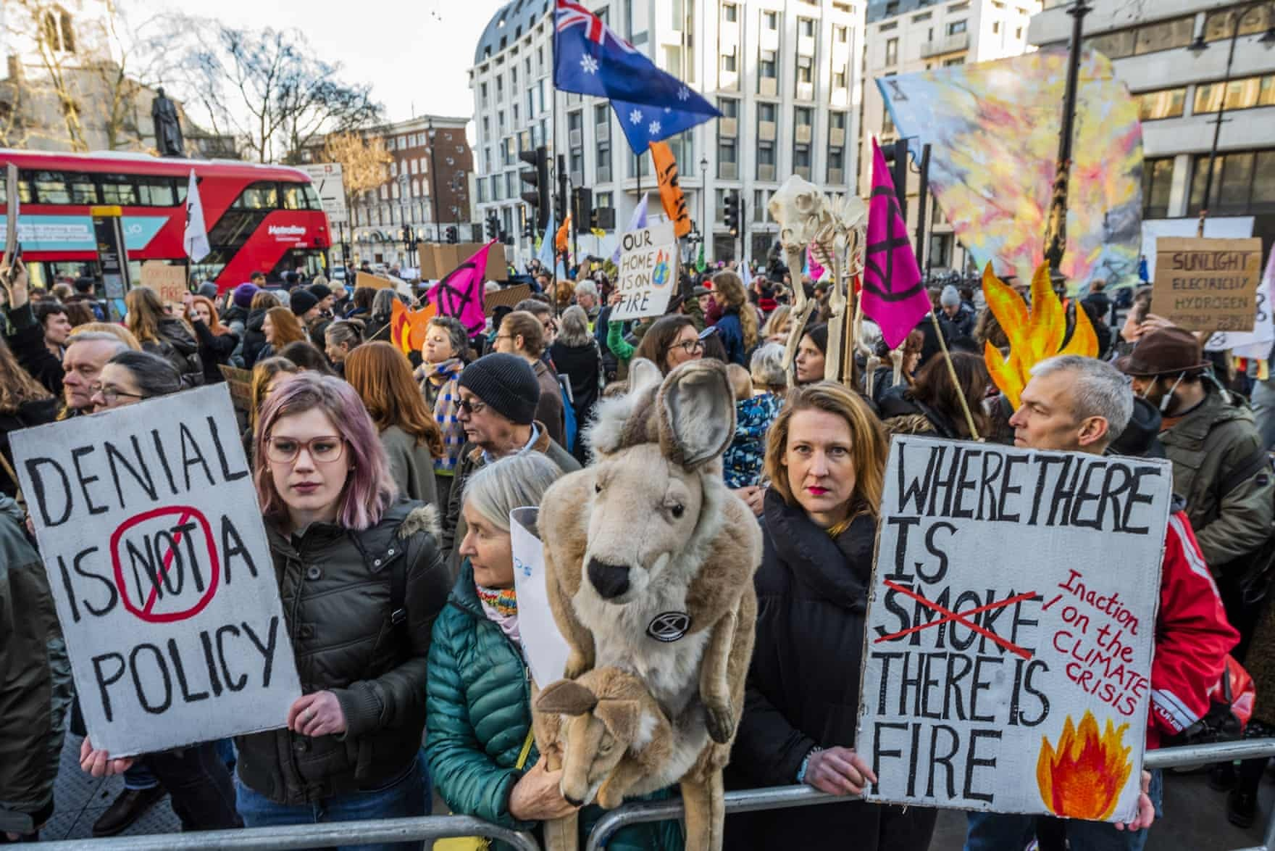
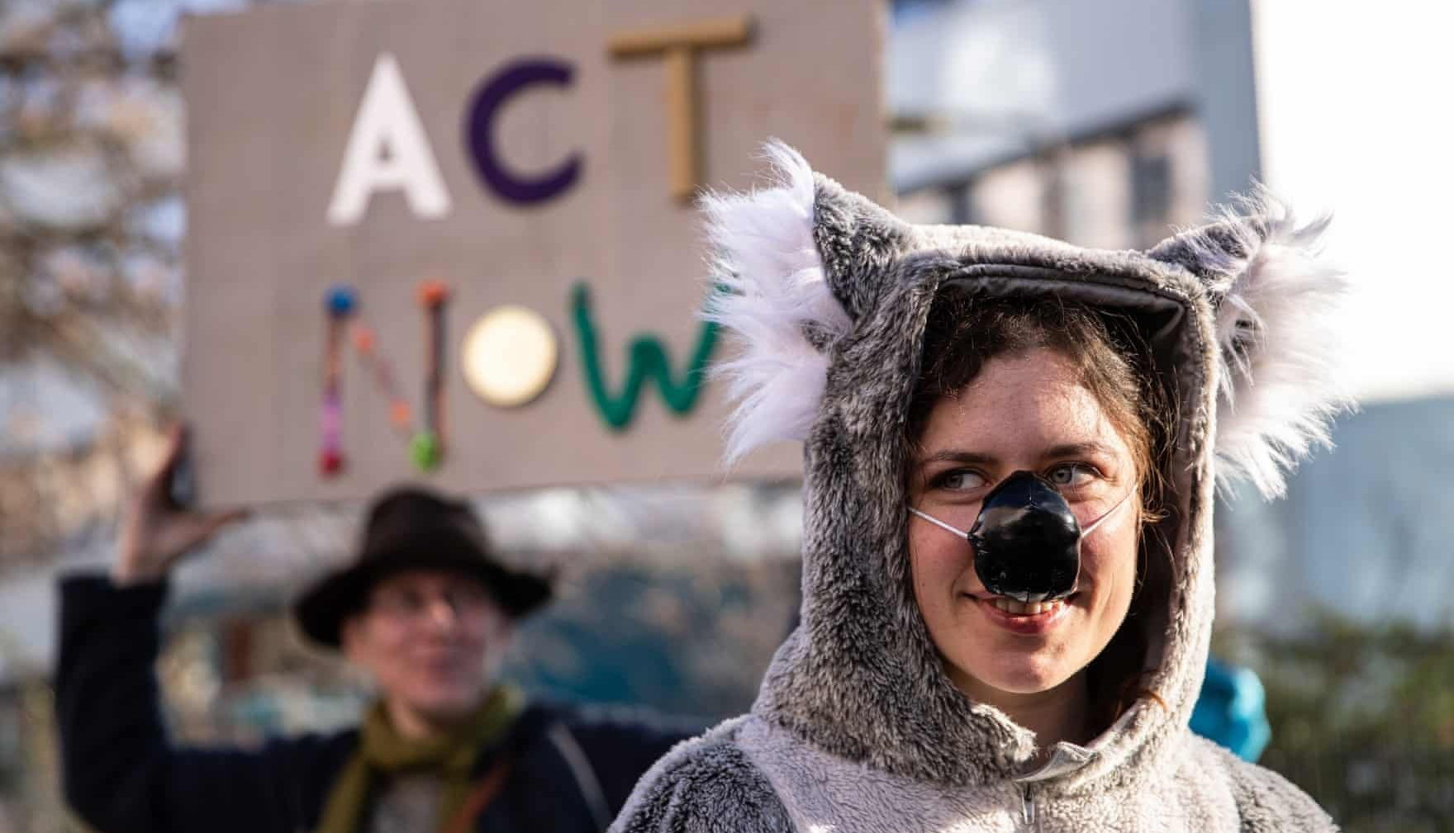

Slide 4
The difference between COVID-19 propaganda and the propaganda about climate change and global warming is that the first one scares people, while the other one propagates much lower numbers and that everything is in order, that we have centuries until it would start affecting us big time. It already is affecting us big time but all the world leaders and world biggest companies control what we're being told.
This virus is supposedly much deadlier than what Earth can do to us by itself. One virus, probably even man-made, is more dangerous from the entire planet we live on and its rage? That's an interesting concept, please tell me more.

Slide 5
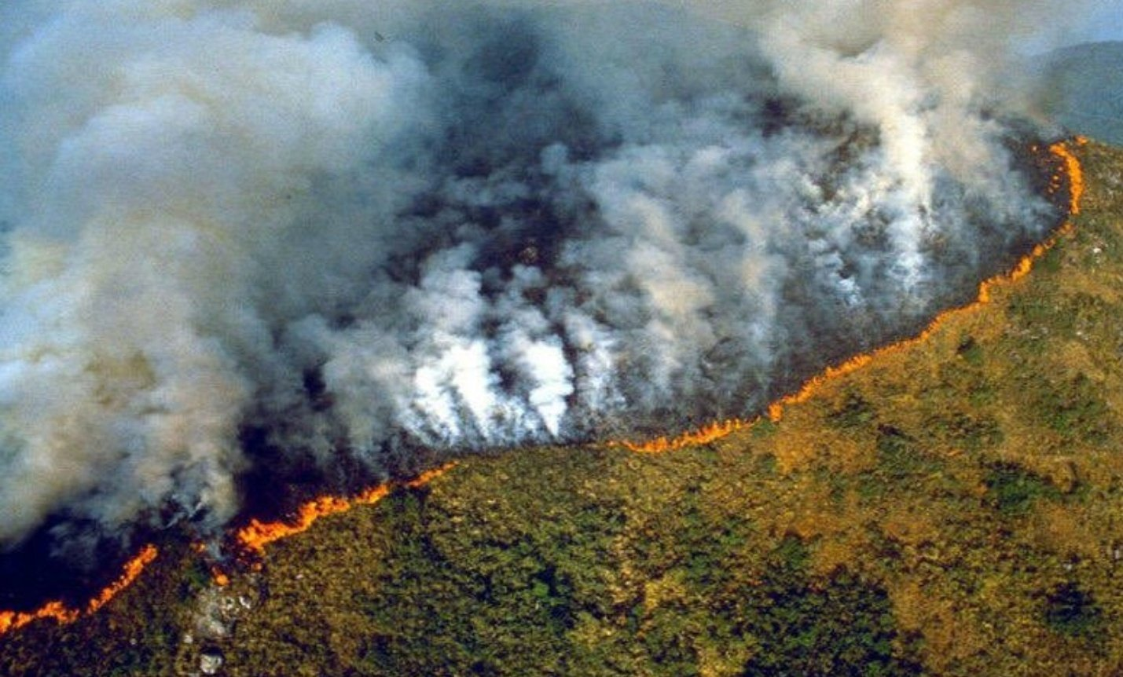
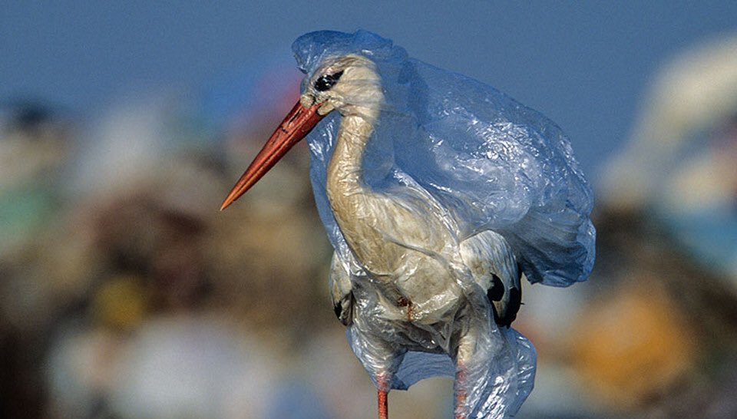
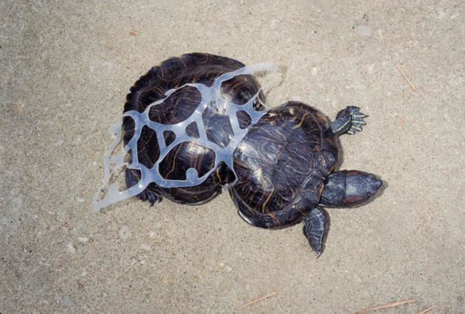
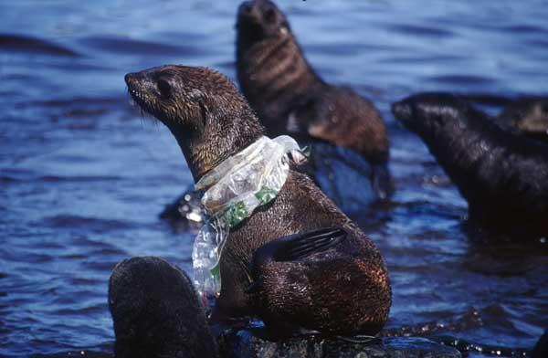
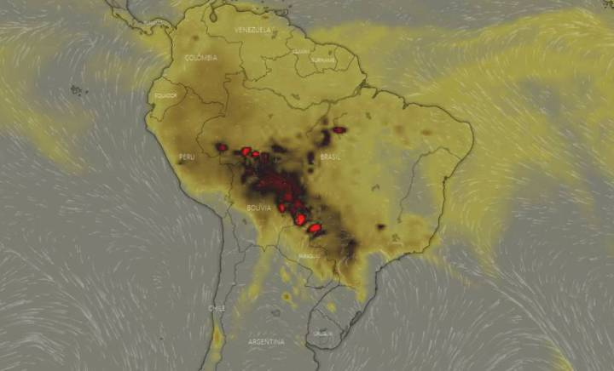
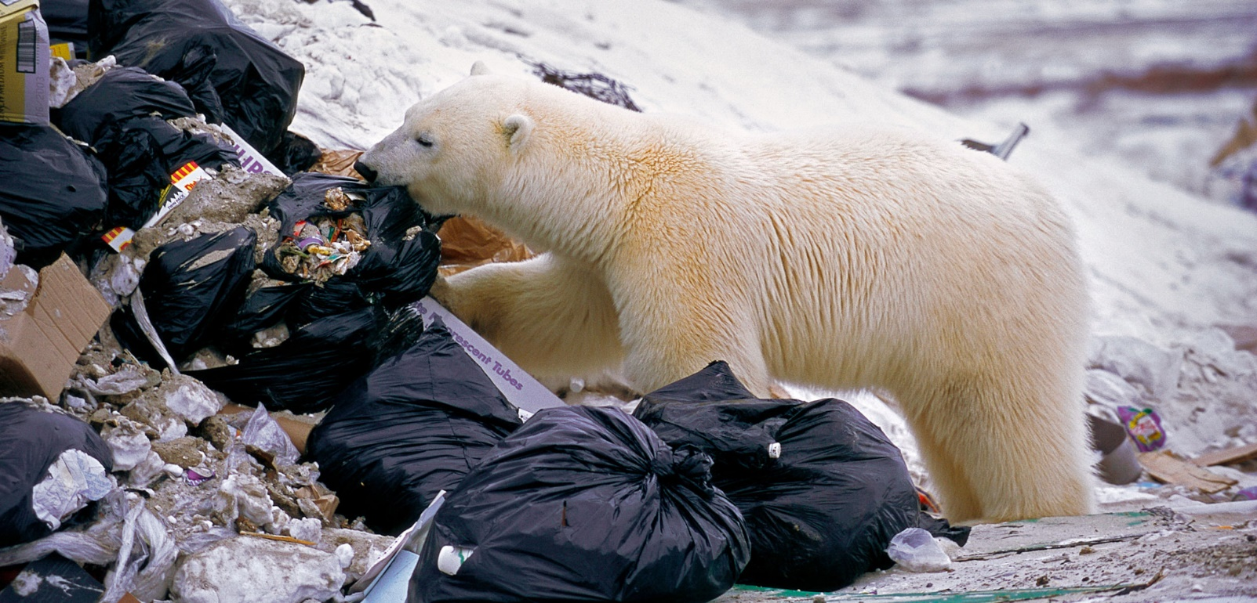
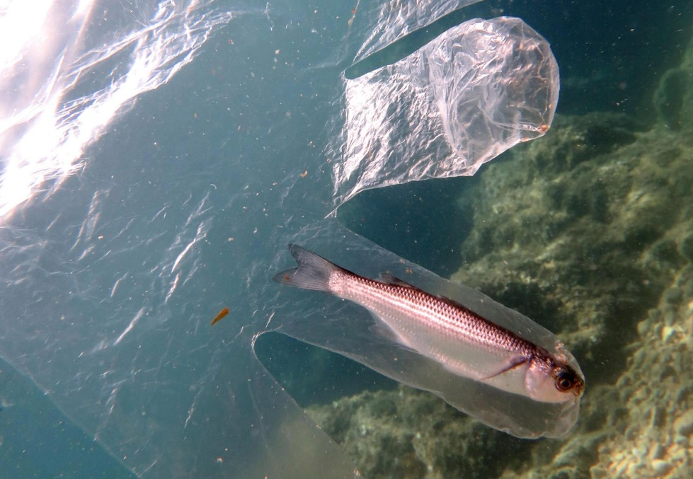

Slide 6
Yes, this all affects the climate. If it affects the living creatures on this planet than how could it not affect the entire system this planet is built upon? If we want nature to nurture us, we have to nurture her by starting with being more aware of our surroundings and what our actions might create or destroy.

Slide 7
Thank God for this lockdown because only now we see how much evil we have created and without us being out and about doing the same old things we have been doing for a longer time, the entire ecosystems are recovering. We have given this planet a break by not doing anything. It really tells us a lot about what or, as a matter of fact, WHO is the actual virus here.

Slide 8
This is my letter for the human race in the future, for after all this COVID-19 mayhem ends. I hope we do better and I hope this manages to teach us about the true values of life. If we don't respect our planet, it surely won't respect us back and its respect is much more important - to us.

Slide 9
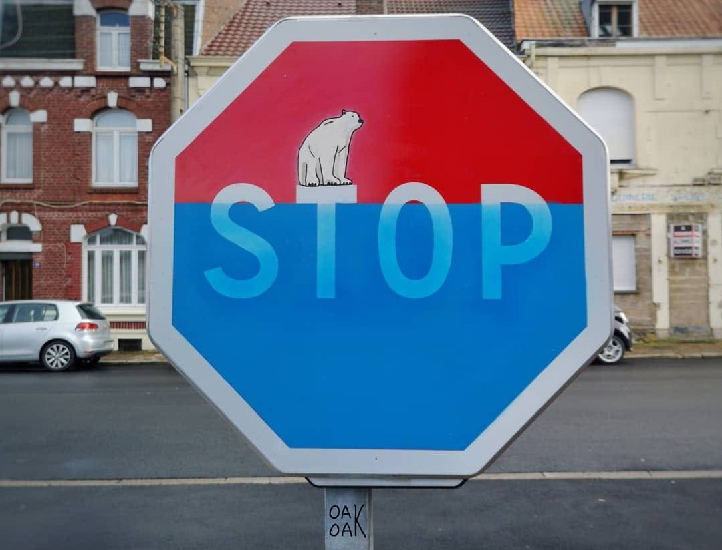

Slide 10
SINCERELY,
KANITA TAFRO
P.S. I WOULD VERY MUCH LIKE TO HAVE A HABITABLE PLANET FOR A LITTLE MORE, I’D LIKE YOU TO HELP ME WITH THAT

Slide 11


